Slide 1


Slide 2




—Satya Nadella (Microsoft’s CEO)
Microsoft
In March 2023
“Today marks the next major step in the evolution of how we interact with computing, which will fundamentally change the way we work and unlock a new wave of productivity growth.”
Copilot
OpenAI
Notes:
This video introduced Microsoft latest AI assistant Copilot. Copilot builds on the technology of OpenAI. It is integrated with the Microsoft 365 products which can unify your working data to help you unleash creativity and increase productivity. Copilot is a huge leap for Microsoft in improving people’s working productivity. However, this achievement did not happen overnight but due to Microsoft’s continuous efforts in developing professional market. One of the most significant efforts is the deal to acquire LinkedIn in 2016, which is the topic of our presentation.

Slide 3
Microsoft Acquired LinkedIn
Microsoft
L2G2
120020209 Wenqian Shangguan
120020421 Mingxi Tang
120090189 Mao Zheng
120090471 Yujie Xiao
120090613 Yichen Zhang
120090888 Weiyuan Xu
121090230 Feihong Jiang

Slide 4
Table of contents
01
02
03
Company Information
DCF Analysis
Summary
Introduction of Microsoft and LinkedIn
1. Compare with the observed market data
2. Determine the valuation
1. Project free cash flows (FCFs)
2. Estimate WACC
3. Calculate terminal value (TV)
4. Calculate present value (PV)
5. Sensitivity analysis

Slide 5
01
Company
Information regarding the acquirer and the target.

Slide 6

Microsoft Acquired LinkedIn
Microsoft announced on June 13, 2016 that it would acquire LinkedIn.
Bid price: $196 per share
Closed price on Friday: $131.08 per share
Total transaction value: $26.2 billion
The deal is expected to close in 2016.
After the announcement:
-LinkedIn's stock price surged 47%
-Microsoft's stock price fell by 3.2%
50% premium！
Source: NY Times news article
Notes:
Microsoft acquired LinkedIn on June 13th, 2016, with the bid price of $196 per share, which include a nearly 50% premium. The total transaction value is 26.2 billion, it was the largest acquisition in Microsoft’s history by 2016. The deal is expected to close in 2016. Therefore, people expect that this deal would be very likely to close. After the announcement, LinkedIn's stock price surged 47%, while Microsoft's stock price fell by 3.2%.

Slide 7

Introduction of LinkedIn
Value Propositions
LinkedIn
The world’s largest and most valuable professional network
Stay connected & informed
LinkedIn helps members keep up with their connections with relevant news and ideas
433M+ members
200+ countries and territories
Mission:
Connect the world’s professionals to make them more productive and successful
Vision:
Create economic opportunities for every member of the global workforce
Advance my career
Help members both get hired and learn new skills
Work smarter
Enable members to establish and manage reputation through their LinkedIn profile
Build professional network
Source: LinkedIn 2015 Annual Report
Notes:
To fully understand the deal, I would like to first introduce the Target, LinkedIn. LinkedIn is the world's largest professional network on the internet. It had over 400 million members in over 200 countries in 2016. It committed to a mission to connect the world’s professionals to make them more productive and successful. This mission is supported by three value propositions. Stay connected & informed: LinkedIn helps members keep up with their connections with relevant news and ideas. The other two are advance my career and work smarter. LinkedIn strives to help members get hired and learn new skills.

Slide 8

Introduction of LinkedIn
Three Product Lines
Talent Solutions
Marketing Solutions
Premium Subscriptions
Talent Solutions revenue is comprised of Hiring and Learning & Development products
Selling various subscriptions to customers that allow users to have further access to premium services on LinkedIn
Marketing Solutions revenue is earned from advertisements on LinkedIn.com
Source: LinkedIn 2015 Annual Report
Notes:
It has three product lines: including Talent Solutions, Market Solutions, and premium subscriptions. (revenue is comprised of Hiring and Learning & Development products) Second Market Solutions, this revenue is earned from advertisements. And third revenue comes from premium subscriptions, LinkedIn sells various subscriptions to customers that allow users to have further access to premium services on LinkedIn.com。 From this information, we now build a general graph of the target company. We know that LinkedIn has the largest professional network. But, this cannot fully explain why Microsoft is willing to pay such high premium to acquire LinkedIn. To answer this question, we need further explore Microsoft’s perspective.

Slide 9
From Microsoft’s Perspectives
Microsoft redefined its strategy in 2015:
Build best-in-class platforms and productivity services for a mobile-first, cloud-first world
Three interconnected ambitions:
Reinvent productivity and business processes
Build the intelligent cloud platform
Create more personal computing
Focus change to professional market
Source: Microsoft 2015 Annual Report
Notes:
In 2015, Microsoft redefined its strategy as to build best-in-class platforms and productivity services for a mobile-first, cloud-first world. To carry out this strategy, Microsoft changed reporting of its financial focus on three interconnected ambitions:
Reinvent productivity and business processes,
build the intelligent cloud platform, and
create more personal computing. Started from here, Microsoft changed its focus to professional market, aiming to reinvent ways to make professionals more productive. However, Even though Microsoft itself has more than 1.2 billion Office users, it didn’t have a social graph and has to rely on Facebook, LinkedIn, and others to provide that key connection. The lack of social graph can be complemented by LinkedIn.

Slide 10
From Microsoft’s Perspectives
Microsoft and LinkedIn share a common mission centered on empowering people and organization
Empower people and organization
Microsoft
Empower every person and every organization on the planet to achieve more
LinkedIn
Connect the world’s professionals to make them more productive and successful
Source:
Microsoft press release
Microsoft investor presentation
Microsoft investor call transcript
Notes:
LinkedIn and Microsoft share a common mission to empower people and organizations. By connecting the world’s leading professional cloud and the professional network, Microsoft can create more connected, intelligent, and productive experiences.

Slide 11

From Microsoft’s Perspectives
Source: Microsoft investor presentation
Notes:
These two graphs showing Microsoft and LinkedIn’s business respectively.

Slide 12
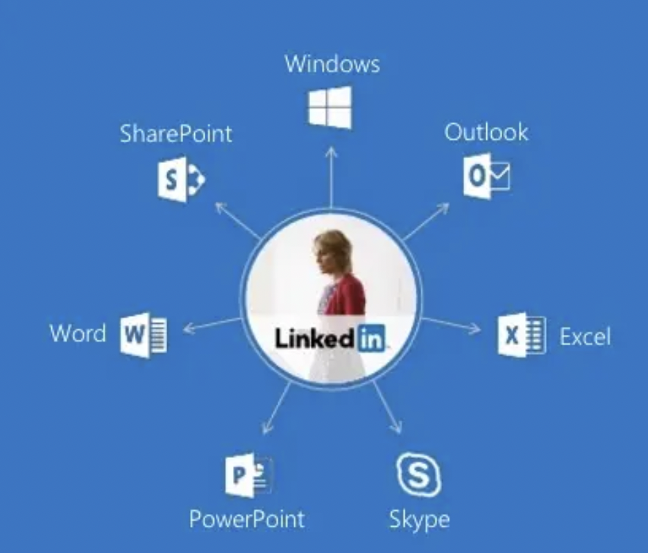
Great Synergies!
After combination:
A Larger Total Addressable Market
$115B
LinkedIn
$315B
New TAM,
up 58%
$200B
Microsoft’s Productivity & Business Process Segment
Source: Microsoft investor presentation
Notes:
After the combination, a professional’s profile will be unified and the right data about the professional will surface in one app of Microsoft, either Skype, outlook or office. This acquisition also enables Microsoft to seize more of the total addressable market of professionals. After combining Microsoft’s productivity and business process segment with LinkedIn’s business, the total addressable market reaches 315 billion dollars, which generates great synergies for the two firms.

Slide 13
02
DCF analysis
Project free cash flows (FCFs)
Estimate WACC
Calculate terminal value (TV)
Calculate present value (PV)
Sensitivity analysis
Notes:
Thank you so much, mingxi.
Now Here comes our analytical part~
We conduct our valuation analysis using dcf model, that is, absolute valuation method.
As we all know, there are essentially four steps for dcf model.
The first step is to determine the free cash flow. Then, in order to discount back to today, we need to compute the WACC.
Subsequently, we calculate the terminal value using two methods, that is, the perpetuity growth method and exit multiple method.
Finally, we discount all the cash flow back and get the present value, that is, the expected enterprise value of linkedin.
Although we will give the point estimation for the final enterprise value. We know that, in statistics, interval estimation is also important, it reveals the robustness of our estimation and reveal the potential sensitive variables.

Slide 14

DCF-Step1: Project Free Cash Flows
Total Revenues - Overview
Year (Historical Performance) | Dec. 31, 2010 | Dec. 31, 2011 | Dec. 31, 2012 | Dec. 31, 2013 | Dec. 31, 2014 | Dec. 31, 2015 | Trend
Total Revenues ($ thousand) | 243,099 | 522,189 | 972,309 | 1,528,545 | 2,218,767 | 2,990,911 | N/A
Growth Rate |  | 114.81% | 86.20% | 57.21% | 45.16% | 34.80%
Year (Predicted Performance) | Dec. 31, 2016 | Dec. 31, 2017 | Dec. 31, 2018 | Dec. 31, 2019 | Dec. 31, 2020
Total Revenues ($ thousand) | 3,900,000 | 4,400,000 | 5,350,742 | 6,527,905 | 7,964,044
Growth Rate | 30.40% | 12.82% | 22.00% | 22.00% | 22.00%
Notes:
Let’s go. Step 1, determine the fcf.
In capital budgeting, we know that the incremental cash flow is equal to operating cash flow - capital expenditure – change in net working capital.
Furthermore, for operating cash flow, it is equal to (revenue – cost – depreciation and amortization) (1- tax rate), and finally add back the depreciation and amortization.
The very first step is to determine the total revenues. And here is the overview of the historical performance and predicted performance of total revenues.

Slide 15
DCF-Step1: Project Free Cash Flows
Total Revenues – Historical Performance
Year (Historical Performance) | Dec. 31, 2010 | Dec. 31, 2011 | Dec. 31, 2012 | Dec. 31, 2013 | Dec. 31, 2014 | Dec. 31, 2015 | Trend
Total Revenues ($ thousand) | 243,099 | 522,189 | 972,309 | 1,528,545 | 2,218,767 | 2,990,911 | N/A
Growth Rate |  | 114.81% | 86.20% | 57.21% | 45.16% | 34.80%
Explanations for the trend of the Observed Growth Rates
Notes:
Let’s firstly look at the historical performance of total revenue.
The data are collected from the annual reports of linkedin from 2010 to 2015.
As the mini graph suggests, obviously, the growth rate of total revenue is decreasing.
So, naturally, there are two questions arising.
The first question is that whether this decreasing trend is within linkedin’s expectation. By answering this question, we will have a better idea of estimating linkedin’s future total sale.
The second concern is the underlying reasons for this decreasing trend in revenue growth rate.

Slide 16
DCF-Step1: Project Free Cash Flows
Total Revenues – Historical Performance
Year (Historical Performance) | Dec. 31, 2010 | Dec. 31, 2011 | Dec. 31, 2012 | Dec. 31, 2013 | Dec. 31, 2014 | Dec. 31, 2015 | Trend
Total Revenues ($ thousand) | 243,099 | 522,189 | 972,309 | 1,528,545 | 2,218,767 | 2,990,911 | N/A
Growth Rate |  | 114.81% | 86.20% | 57.21% | 45.16% | 34.80%
Explanation 1 – Consistency with the Expectation
“We expect our revenue growth rate to decline, and, as our costs increase, we may not be able to generate sufficient revenue to sustain profitability over the long term.”
Source: LinkedIn 2015 Annual Report
Notes:
Let’s firstly investigate the first question. That is, whether this decreasing trend of growth rate is within linkedin’s expectation.
The answer is, YES. This decreasing trend is consistent with the expectation.
How to get this information?
We further look at the annual report of linkedin in 2015, and it is said that “We expect our revenue growth rate to decline, and, as our costs increase, we may not be able to generate sufficient revenue to sustain profitability over the long term.”
So, we are relatively certain that the revenue growth rate will continue to decline after 2015, that is, the growth rates afterwards should be forecastes smaller that 34.8 percent.

Slide 17
DCF-Step1: Project Free Cash Flows
Total Revenues – Historical Performance
Year (Historical Performance) | Dec. 31, 2010 | Dec. 31, 2011 | Dec. 31, 2012 | Dec. 31, 2013 | Dec. 31, 2014 | Dec. 31, 2015 | Trend
Total Revenues ($ thousand) | 243,099 | 522,189 | 972,309 | 1,528,545 | 2,218,767 | 2,990,911 | N/A
Growth Rate |  | 114.81% | 86.20% | 57.21% | 45.16% | 34.80%
Explanation 2 – Two Possibilities
Employment Perspective: "We may not be able to hire new employees quickly enough to meet our needs."
Product & Service Perspective: "We may also decide to discontinue certain features, products or services, or charge for certain features, products or services that are currently free or increase fees for any of our features, products or services. If members or customers are unhappy with these changes, they may decrease their engagement on our site, or stop using features, products or services or the site generally."
Source: LinkedIn 2015 Annual Report
Notes:
Then, the second question, that is, the reasons behind this decreasing trend.
In order to find the internal information and try our best to avoid the subjective or cursory guess, we also refer to the annual report.
After reviewing the whole annual report, we found that there are two highlighted reasons.
The first reason is from employment perspective. It is said that "We may not be able to hire new employees quickly enough to meet our needs.”
That is, as the company’s revenues grew, the scale of its workforce failed to keep pace with this progress.
The second reason is about product and service. Because Linkedin is an Internet company whose product is the software itself. Software’s functions and services need to be changed periodically, and sometimes these changes will lead to user dissatisfaction, which will lead to the fluctuation of the number of users. Finally, as the product matures, the number of users tends to stabilize later. So the growth rate tend to converge.

Slide 18
DCF-Step1: Project Free Cash Flows
Total Revenues – Predicted Performance
Year (Predicted Performance) | Dec. 31, 2016 | Dec. 31, 2017 | Dec. 31, 2018 | Dec. 31, 2019 | Dec. 31, 2020
Total Revenues ($ thousand) | 3,900,000 | 4,400,000 | 5,350,742 | 6,527,905 | 7,964,044
Growth Rate | 30.40% | 12.82% | 22.00% | 22.00% | 22.00%
Explanations for the first two Forecasted Growth Rates (2016 – 2017)
Notes:
After collecting and interpreting the historical performance of the total revenues, here comes to the forecasting part.
Let us firstly look at the first two years data. Since they are forecasted by financial analyst.
In the first two years of forecasting, we used their analysis because they may have some inside information and some more sophisticated forecasting methods.

Slide 19
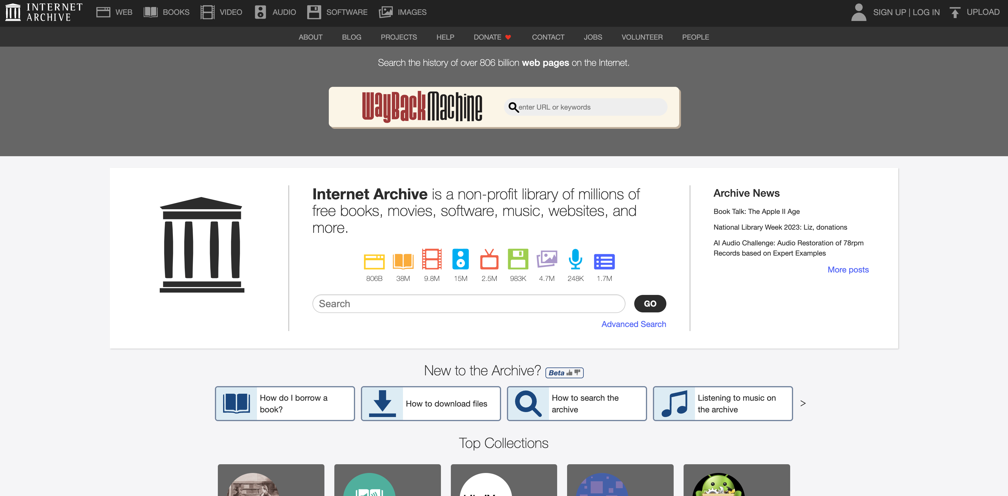
DCF-Step1: Project Free Cash Flows
Total Revenues – Predicted Performance
Year (Predicted Performance) | Dec. 31, 2016 | Dec. 31, 2017 | Dec. 31, 2018 | Dec. 31, 2019 | Dec. 31, 2020
Total Revenues ($ thousand) | 3,900,000 | 4,400,000 | 5,350,742 | 6,527,905 | 7,964,044
Growth Rate | 30.40% | 12.82% | 22.00% | 22.00% | 22.00%
Source: Internet Archive (archive.org)
Notes:
Linkedin has been delisted since it was acquired. The financial forecasts at that time, that is, in the year of 2016, are no longer publicly available. It's very frustrating for us.
Does that mean we really don‘t have access to predictive data in 2016? Absolutely not.
Here is the trick. Let me show you.
We leveraged the help of this tool. It is called internet archive. And with its help, we can get the static mirror page of the public financial website which did forecasting for linkedin at that time.

Slide 20
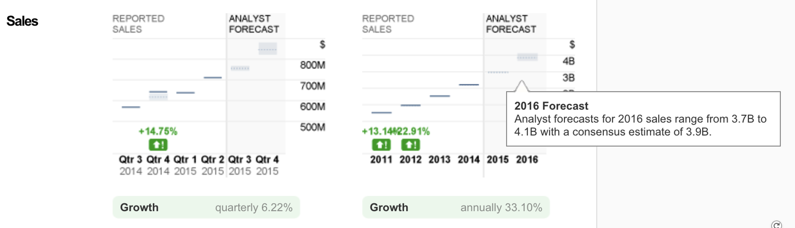
DCF-Step1: Project Free Cash Flows
Total Revenues – Predicted Performance
Year (Predicted Performance) | Dec. 31, 2016 | Dec. 31, 2017 | Dec. 31, 2018 | Dec. 31, 2019 | Dec. 31, 2020
Total Revenues ($ thousand) | 3,900,000 | 4,400,000 | 5,350,742 | 6,527,905 | 7,964,044
Growth Rate | 30.40% | 12.82% | 22.00% | 22.00% | 22.00%
Source: CNN Business (https://money.cnn.com)
Notes:
The data in the picture shows the result of forecasting at that time. It is from CNN Business.
It is estimated that the total revenues in 2016 would be 3.9 billion and in 2017 it would be 4.4 billion.
As a result, we can compute the corresponding revenue growth rates are 30.4% and 12.82%.

Slide 21
DCF-Step1: Project Free Cash Flows
Total Revenues – Predicted Performance
Year (Predicted Performance) | Dec. 31, 2016 | Dec. 31, 2017 | Dec. 31, 2018 | Dec. 31, 2019 | Dec. 31, 2020
Total Revenues ($ thousand) | 3,900,000 | 4,400,000 | 5,350,742 | 6,527,905 | 7,964,044
Growth Rate | 30.40% | 12.82% | 22.00% | 22.00% | 22.00%
Explanations for the three latter Forecasted Growth Rates (2018 – 2020)
Notes:
From the above analysis, we know that the revenue growth rate is decreasing from 2010 to 2015, so the growth rate should be at least lower than 34.8%.
We also know that, the forecasted growth rates for the first two years are 30.4% and 12.82%.
Considering the above two conditions, we take the average of 30.4% and 12.82%, which is approximately 22% as the revenue growth rates for three latter years.
The next part following the revenue analysis is the costs. My partner Yujie will continue our analysis.
Welcome, yujie.

Slide 22
DCF-Step1: Project Free Cash Flows
Category of Costs and D&A
Total Costs and D&A | Descriptions
Cost of Revenue | Operating Cost
SG&A | Non-Operating Cost
Depreciation and Amortization | For the purpose of Tax Reduction

Slide 23
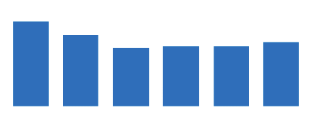
DCF-Step1: Project Free Cash Flows
Cost of Revenue
Year (Historical Performance) | Dec. 31, 2010 | Dec. 31, 2011 | Dec. 31, 2012 | Dec. 31, 2013 | Dec. 31, 2014 | Dec. 31, 2015 | Trend
Cost of Revenue ($ thousand) | 44,826 | 81,448 | 125,521 | 202,908 | 293,797 | 418,858 | N/A
% of Total Revenues | 18.44% | 15.60% | 12.91% | 13.27% | 13.24% | 14.00%
Year (Predicted Performance) | Dec. 31, 2016 | Dec. 31, 2017 | Dec. 31, 2018 | Dec. 31, 2019 | Dec. 31, 2020
Cost of Revenue ($ thousand) | 568,534 | 641,423 | 780,020 | 880,019 | 992,838
% of Total Revenues | 14.58% | 14.58% | 14.58% | 14.58% | 14.58%

Slide 24

DCF-Step1: Project Free Cash Flows
Selling, General, and Administrative Expenses
Year (Historical Performance) | Dec. 31, 2010 | Dec. 31, 2011 | Dec. 31, 2012 | Dec. 31, 2013 | Dec. 31, 2014 | Dec. 31, 2015 | Trend
SG&A ($ thousand) | 159,146 | 371,796 | 710,077 | 1,143,309 | 1,651,889 | 2,302,523 | N/A
% of Total Revenues | 65.47% | 71.20% | 73.03% | 74.80% | 74.45% | 76.98%
Year (Predicted Performance) | Dec. 31, 2016 | Dec. 31, 2017 | Dec. 31, 2018 | Dec. 31, 2019 | Dec. 31, 2020
SG&A ($ thousand) | 2,833,525 | 3,196,798 | 3,887,554.56 | 4,385,939.05 | 4,948,216.44
% of Total Revenues | 72.65% | 72.65% | 72.65% | 72.65% | 72.65%

Slide 25
DCF-Step1: Project Free Cash Flows
Selling, General, and Administrative Expenses
Year (Historical Performance) | Dec. 31, 2010 | Dec. 31, 2011 | Dec. 31, 2012 | Dec. 31, 2013 | Dec. 31, 2014 | Dec. 31, 2015 | Trend
SG&A (thousand) | 159,146 | 371,796 | 710,077 | 1,143,309 | 1,651,889 | 2,302,523 | N/A
% of Total Revenues | 65.47% | 71.20% | 73.03% | 74.80% | 74.45% | 76.98%
Explanation for the high steady % of Total Revenues
1. LinkedIn's business model relies heavily on its user base, which is its primary source of revenue. To maintain and expand its user base, the company invests in various sales and marketing activities, such as sales commissions, sales and marketing personnel, and promotional campaigns, which are all part of its SG&A expenses.
2. Additionally, LinkedIn has a large global workforce, which also contributes to its SG&A expenses.
Source:
Analysis of LinkedIn's SG&A expenses by Simply Wall St
Analysis of LinkedIn's sales and marketing expenses by Zacks Investment Research

Slide 26
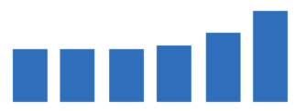
DCF-Step1: Project Free Cash Flows
Depreciation and Amortization
Year (Historical Performance) | Dec. 31, 2010 | Dec. 31, 2011 | Dec. 31, 2012 | Dec. 31, 2013 | Dec. 31, 2014 | Dec. 31, 2015 | Trend
D&A ($ thousand) | 19,551 | 43,100 | 79,849 | 134,516 | 236,946 | 420,472 | N/A
% of Total Revenues | 8.04% | 8.25% | 8.21% | 8.80% | 10.68% | 14.06%
Year (Predicted Performance) | Dec. 31, 2016 | Dec. 31, 2017 | Dec. 31, 2018 | Dec. 31, 2019 | Dec. 31, 2020
D&A ($ thousand) | 377,300 | 425,672 | 517,650 | 584,013 | 658,884
% of Total Revenues | 9.67% | 9.67% | 9.67% | 9.67% | 9.67%

Slide 27
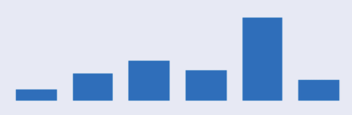
DCF-Step1: Project Free Cash Flows
Income Taxes
Year (Historical Performance) | Dec. 31, 2010 | Dec. 31, 2011 | Dec. 31, 2012 | Dec. 31, 2013 | Dec. 31, 2014 | Dec. 31, 2015 | Trend
EBIT ($ thousand) | 19,576 | 25,845 | 56,862 | 47,812 | 36,135 | (150,942) | N/A
Income Taxes Expense | 3,581 | 11,030 | 35,504 | 22,459 | 46,525 | (49,969) | N/A
% of EBIT | 18.29% | 42.68% | 62.44% | 46.97% | 128.75% | 33.10%
EBIAT | 15,995 | 14,815 | 21,358 | 25,353 | (10,390) | (100,973) | N/A
Explanation for Income Taxes Expense ≈ Provision for Income Taxes (adjustment of taxes credit or deferred taxes = 0)
1. Provision for Income Taxes (PIT) refers to an estimated amount of taxes that a company will owe for a particular period. Income Taxes Expense (ITE) is the actual amount of taxes that a company pays during a particular period.
2. Generally accepted accounting principles (GAAP) require companies to use PIT in financial statements to reflect the estimated tax expense for the period.
Source: An overview of LinkedIn's tax provision and deferred tax assets and liabilities by MarketWatch

Slide 28
DCF-Step1: Project Free Cash Flows
Income Taxes
Year (Historical Performance) | Dec. 31, 2010 | Dec. 31, 2011 | Dec. 31, 2012 | Dec. 31, 2013 | Dec. 31, 2014 | Dec. 31, 2015 | Trend
EBIT ($ thousand) | 19,576 | 25,845 | 56,862 | 47,812 | 36,135 | (150,942) | N/A
Income Taxes Expense | 3,581 | 11,030 | 35,504 | 22,459 | 46,525 | (49,969) | N/A
% of EBIT | 18.29% | 42.68% | 62.44% | 46.97% | 128.75% | 33.10%
EBIAT | 15,995 | 14,815 | 21,358 | 25,353 | (10,390) | (100,973) | N/A
Explanation for Income Taxes Expense ≈ Provision for Income Taxes (adjustment of taxes credit or deferred taxes = 0)
1. First method: check whether adjustment of taxes credit or deferred taxes = 0
2. Second method: check whether ITE and PIT have the same formula.
ITE = EBIT - EBIAT = PIT
3. Corollary: adjustment of taxes credit or deferred taxes = 0

Slide 29
DCF-Step1: Project Free Cash Flows
Income Taxes
Year (Historical Performance) | Dec. 31, 2010 | Dec. 31, 2011 | Dec. 31, 2012 | Dec. 31, 2013 | Dec. 31, 2014 | Dec. 31, 2015 | Trend
EBIT ($ thousand) | 19,576 | 25,845 | 56,862 | 47,812 | 36,135 | (150,942) | N/A
Income Taxes Expense | 3,581 | 11,030 | 35,504 | 22,459 | 46,525 | (49,969) | N/A
% of EBIT | 18.29% | 42.68% | 62.44% | 46.97% | 128.75% | 33.10%
EBIAT | 15,995 | 14,815 | 21,358 | 25,353 | (10,390) | (100,973) | N/A
Year (Predicted Performance) | Dec. 31, 2016 | Dec. 31, 2017 | Dec. 31, 2018 | Dec. 31, 2019 | Dec. 31, 2020
EBIT ($ thousand) | 120,640 | 136,107 | 165,517 | 186,736 | 210,675
Income Taxes Expense | 62,575 | 70,599 | 85,854 | 96,860 | 109,277
% of EBIT | 51.87% | 51.87% | 51.87% | 51.87% | 51.87%
EBIAT | 58,065 | 65,508 | 79,663 | 89,876 | 101,398

Slide 30
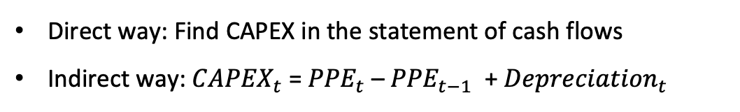
DCF-Step1: Project FCFs-CAPEX
Use historical performance to Calculate CAPEX (Capital Expenditure)
Direct way: Find CAPEX in the statement of cash flows
Indirect way: ${CAPEX}_{t}$ = ${PPE}_{t}$ – ${PPE}_{t−1}$ + ${Depreciation}_{t}$
($ thousand) | Dec. 31, 2009 | Dec. 31, 2010 | Dec. 31, 2011 | Dec. 31, 2012 | Dec. 31, 2013 | Dec. 31, 2014 | Dec. 31, 2015
PPE | 25,730 | 56,743 | 114,850 | 186,677 | 361,741 | 740,909 | 1,047,005
Change of PPE |  | 31,013 | 58,107 | 71,827 | 175,064 | 379,168 | 306,096
Depreciation |  | 19,551 | 43,100 | 79,849 | 134,516 | 236,946 | 420,472
% of total sales |  | 8.04% | 8.25% | 8.21% | 8.80% | 10.68% | 14.06%
CAPEX |  | 50,564 | 101,207 | 151,676 | 309,580 | 616,114 | 726,568
Notes:
So far we have finished our calculation of the operating cash flows. Now let’s come to the CAPEX part. There are two methods to calculate CAPEX: one direct way is to find CAPEX in the statement of cash flows. But when we went through the annual report, we found that LinkedIn didn’t disclose its CAPEX in the cash flow statement. So we use the alternative method, which is the change of PPE plus the depreciation to get the CAPEX for the current year. This table shows our historical data on CAPEX.

Slide 31
DCF-Step1: Project FCFs-CAPEX
Future Forecasting of CAPEX
($ thousand) | 2009 | 2010 | 2011 | 2012 | 2013 | 2014 | 2015
PPE | 25,730 | 56,743 | 114,850 | 186,677 | 361,741 | 740,909 | 1,047,005
Change of PPE |  | 31,013 | 58,107 | 71,827 | 175,064 | 379,168 | 306,096
Estimation of PPE :
Positive change in PPE: PPE increases year by year
Before 2014: increasing change & After 2014: decreasing change
Explanation: Company’s different developing periods
Forecasting: We assume the PPE will increase at a decreasing rate
($ thousand) | 2016 | 2017 | 2018 | 2019 | 2020
PPE | 1,280,029 | 1,439,981 | 1,526,861 | 1,540,669 | 1,481,405
Change of PPE | 233,024 | 159,952 | 86,880 | 13,808 | (59,264)
Notes:
To project the future CAPEX, we break down the CAPEX into two parts. Firstly, let’s look at the PPE part.
I draw a line plot to show the trend of change in PPE in the past 6 years. From the plot we can see that the changes are always positive, which means that the PPE increases year by year. However, before 2014 there is an increasing change and after 2014 there is a decreasing change.
One explanation is that this difference is caused by the company’s different developing periods. In the early stage of the establishment, the company needs to invest a lot of capital in PPE. For example, the company needs to buy enough equipment for operating, rent buildings, and so on. We can regard these investments as something like fixed costs. So we can observe that from the year 2009 to 2014, the PPE of LinkedIn is increasing at an increasing speed. However, this process won’t last forever. At a certain stage,say the year 2014, the company will enter into a period where, although the PPE is still increasing, the increasing speed is slowing down. Because the company is shifting its focus towards operating more.
To forecast the future PPE, we assume that the PPE will continuously increase at a decreasing rate, which means that the change in PPE will get smaller in the following years.
Based on our assumption, the PPE in the following 5 years are shown in the table.

Slide 32
DCF-Step1: Project FCFs-CAPEX
Future Forecasting of CAPEX
A relative steady proportion of total sales
Take average to get the future % of total sales
Estimation of Depreciation :
($ thousand) | 2010 | 2011 | 2012 | 2013 | 2014 | 2015
Depreciation | 19,551 | 43,100 | 79,849 | 134,516 | 236,946 | 420,472
% of total sales | 8.04% | 8.25% | 8.21% | 8.80% | 10.68% | 14.06%
($ thousand) | 2016 | 2017 | 2018 | 2019 | 2020
Depreciation | 377,300 | 425,672 | 517,650 | 631,533 | 770,471
% of total sales | 9.67% | 9.67% | 9.67% | 9.67% | 9.67%
CAPEX | 832,616 | 939,326.67 | 1,142,294.24 | 1,393,598.97 | 1,700,190.74
Notes:
Then we need to estimate the future depreciation. Yujie has done this process in the previous part. We add the depreciation to the change of PPE of each year, to get the CAPEX.

Slide 33
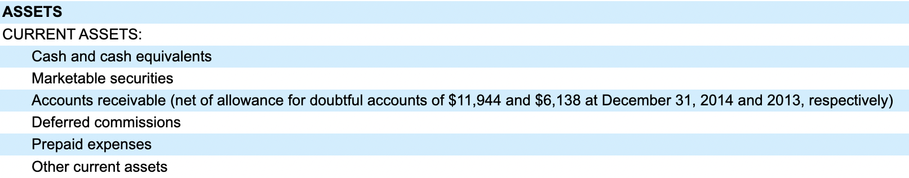
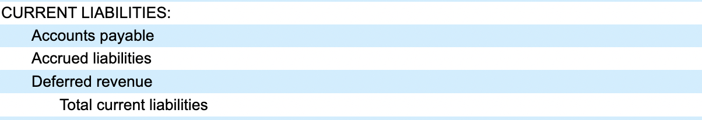
DCF-Step1: Project FCFs-NWC
NWC (Net Working Capital): measures a company's short-term financial health.
Calculation method: Current assets – Current liabilities
We exclude the “Cash and cash equivalents” and “Marketable securities”.
“Our cash equivalents and marketable securities are comprised primarily of US treasury securities, US agency securities, corporate debt securities, commercial paper and money market funds.”
Return on these investments ≠ Return on the firm’s real investments
These parts are irrelevant to the company’s operating activities
Source: LinkedIn 2015 Annual Report
Working capital in valuation-stern.nyu.edu
Notes:
Now let’s project the Net working capital. By definition, the NWC measures a company’s short-term financial health. It is Current assets minus Current liabilities. There are several items related to NWC in the balance sheet. One thing we want to emphasize is that we exclude the “Cash and cash equivalents” and “Marketable securities” regarding the current assets. The annual report said that “Our cash equivalents and marketable securities are comprised primarily of these items.”
However, we should be aware that the return on these investments ≠ Return on the firm’s real investments on operating.
Besides, these parts are irrelevant to the company’s operating activities. Thus, we exclude these terms in NWC.

Slide 34
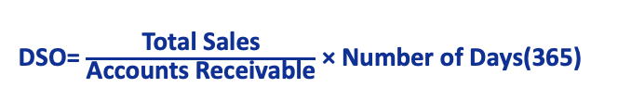
DCF-Step1: Project FCFs-NWC
Historical Performance
Current Assets ($ thousand) | Dec. 31, 2010 | Dec. 31, 2011 | Dec. 31, 2012 | Dec. 31, 2013 | Dec. 31, 2014 | Dec. 31, 2015 | Trend
Accounts receivable | 58,263 | 111,372 | 203,607 | 302,168 | 449,048 | 603,060
DSO | 87.48 | 77.85 | 76.43 | 72.15 | 73.87 | 73.60
Deferred commissions | 8,684 | 13,594 | 30,232 | 47,496 | 66,561 | 87,706
% of total sales | 3.57% | 2.60% | 3.11% | 3.11% | 3.00% | 2.93%
Prepaid expenses and other current assets | 12,308 | 23,457 | 35,409 | 76,505 | 163,182 | 124,941
% of total sales | 5.06% | 4.49% | 3.64% | 5.01% | 7.35% | 4.18%
*DSO (Days Sales Outstanding): a measure of the average number of days that it takes a company to collect payment for a sale.
DSO= $\frac{\text{Total} \text{Sales}}{\text{Accounts} \text{Receivable}\text{​}}$ × Number of Days​(365)
Stable DSO and % of total sales
Take average of DSO, % of total sales to get future estimations
Notes:
Here is the historical performance of the current assets. We use DSO to measure the Accounts receivable, which is the average number of days that it takes to collect payment for a sale. And we use the percentage of total sales to measure the Deferred commissions and Prepaid expenses and other current assets. We observe that the DSO and percentage of total sales are stable. Thus we take the average of them to get future estimations.

Slide 35
DCF-Step1: Project FCFs-NWC
Projection period
Current Assets ($ thousand) | Dec. 31, 2016 | Dec. 31, 2017 | Dec. 31, 2018 | Dec. 31, 2019 | Dec. 31, 2020
Accounts receivable | 821,636 | 926,974 | 1,127,272 | 1,375,272 | 1,677,831
Average DSO | 76.90 | 76.90 | 76.90 | 76.90 | 76.90
Deferred commissions | 119,108 | 134,379 | 163,415 | 199,366 | 243,227
Average % of total sales | 3.05% | 3.05% | 3.05% | 3.05% | 3.05%
Prepaid expenses and other current assets | 193,270 | 218,048 | 265,163 | 323,499 | 394,669
Average % of total sales | 4.96% | 4.96% | 4.96% | 4.96% | 4.96%

Slide 36
DCF-Step1: Project FCFs-NWC
Historical Performance
Current Liabilities ($ thousand) | Dec. 31, 2010 | Dec. 31, 2011 | Dec. 31, 2012 | Dec. 31, 2013 | Dec. 31, 2014 | Dec. 31, 2015 | Trend
Accounts payable | 12,886 | 28,217 | 53,559 | 66,744 | 100,297 | 162,176
DPO | 104.9255 | 126.4513 | 155.7431 | 120.0621 | 124.6044 | 141.3229
Deferred revenues | 64,985 | 139,798 | 257,743 | 392,243 | 522,299 | 709,116
% of total sales | 26.73% | 26.77% | 26.51% | 25.66% | 23.54% | 23.71%
Accrued expenses and other current liabilities | 27,601 | 58,644 | 104,077 | 183,004 | 260,189 | 316,792
% of total sales | 11.35% | 11.23% | 10.70% | 11.97% | 11.73% | 10.59%
*DPO (Days payable outstanding) : measures how many days, on average, it takes a company to pay its suppliers.
DPO = accounts payable x number of days (365) / cost of goods sold
High DPO: Preferable for working capital management
Stable DPO and % of total sales
Take average of DPO, % of total sales to get future estimations
Notes:
In the current liabilities, we use DPO to measure the Accounts payable. DPO means how many days, on average, it takes a company to pay its suppliers. A high DPO is preferable from a working capital management point of view. Because if a company takes a long time to pay its suppliers,it can continue to make use of its cash for a longer period.
And we also use the percentage of total sales to measure the Deferred revenues and Accrued expenses and other current liabilities. We find that the DPO and percentage of total sales are stable. Thus we take the average of them to get future estimations.

Slide 37
DCF-Step1: Project FCFs-NWC
Projection period
Current Liabilities ($ thousand) | Dec. 31, 2016 | Dec. 31, 2017 | Dec. 31, 2018 | Dec. 31, 2019 | Dec. 31, 2020
Accounts payable | 200,703 | 226,434 | 275,361 | 335,941 | 409,848
Average DPO | 128.8516 | 128.8516 | 128.8516 | 128.8516 | 128.8516
Deferred revenues | 993,980 | 1,121,413 | 1,363,726 | 1,663,745 | 2,029,769
Average % of total sales | 25.49% | 25.49% | 25.49% | 25.49% | 25.49%
Accrued expenses and other current liabilities | 439,205 | 495,513 | 602,583 | 735,151 | 896,884
Average % of total sales | 11.26% | 11.26% | 11.26% | 11.26% | 11.26%
Net working capital | (499,874) | (563,960) | (685,820) | (836,700) | (1,020,774)
Change in NWC | (127,497) | (64,086) | (121,859) | (150,880) | (184,074)
Notes:
Here is the estimated change of NWC of each year.

Slide 38
DCF-Step1: Project FCFs-NWC
Projection period
Current Liabilities ($ thousand) | Dec. 31, 2016 | Dec. 31, 2017 | Dec. 31, 2018 | Dec. 31, 2019 | Dec. 31, 2020
Net working capital | (499,874) | (563,960) | (685,820) | (836,700) | (1,020,774)
Change in NWC | (127,497) | (64,086) | (121,859) | (150,880) | (184,074)
Negative NWC:
LinkedIn is using supplier credit as a source of capital
Default risk & potential cost
Negative change in NWC:
Releases tied-up cash and increases the cash flow of the firm, increase management efficiency
Further decreases in working capital can have negative consequences for revenue growth and profits
Source: Working capital in valuation-stern.nyu.edu
Notes:
We observe that the NWC is negative, which means that LinkedIn’s current liabilities exceed non-cash current assets. This is a thornier issue. On the one hand, this means that LinkedIn is using supplier credit as a source of capital. That is to say, the firm is growing from borrowing others’ money. However, on the other hand, there are some potential downsides. A negative NWC is usually viewed by accountants and rating agencies as a source of default risk. There may be costs created for other capital by using supplier credit as a source.
We also notice the negative change in NWC. When NWC decreases, it releases tied-up cash and increases the cash flow of the firm. At the sametime, it means that the firm is managing more efficiently. However, this negative change in NWC should not last long. Further decreases in working capital can have negative consequences for revenue growth and profits.

Slide 39
DCF-Step1: Project Free Cash Flows
Free Cash Flow = Operating cash flow – CAPEX – Change in NWC
($ thousand) | Dec. 31, 2016 | Dec. 31, 2017 | Dec. 31, 2018 | Dec. 31, 2019 | Dec. 31, 2020
Operating Cash Flow | 422,191 | 476,318 | 579,240 | 706,672 | 862,140
CAPEX | 610,324 | 585,624.06 | 604,530.31 | 597,821.08 | 599,619.56
Change in NWC | (127,497) | (64,086) | (121,859) | (150,880) | (184,074)
Free Cash Flow | (60,636) | (45,220) | 96,569 | 259,732 | 446,595
Notes:
So let’s conclude our free cash flow part. Recall that our Free Cash Flow = Operating cash flow – CAPEX – Change in NWC
By combining these terms together, we get the free cash flow for the coming 5 years.
Now let’s welcome Feihong to introduce the WACC part.

Slide 40


DCF-Step2: Estimate WACC
01
Estimate target capital structure (D/E)
02
Estimate cost of debt ($r_{d}$)
03
Estimate cost of equity ($r_{e}$)
04
Calculate WACC

Slide 41
DCF-Step2: Estimate WACC
Estimate Target Capital Structure
Capital Structure
Common shares outstanding (million) | 123.81
Share price on June 7, 2016 | $135.70
Market value of equity (million) | $16,801.02
Long-term debt (million) | $1,322.5
Total capitalization (million) | $18,123.52
Calculate the proportion of debt and equity in total capitalization
Imply the basic framework of WACC
Source: https://xueqiu.com/S/LNKD

Slide 42
What in the annual report:
DCF-Step2: Estimate WACC
Estimate Cost of Debt
1.On November 12, 2014, the Company issued $1,322.5 million aggregate principal amount of convertible senior notes (the “Notes”).
2.The Notes mature on November 1, 2019, unless converted, and bear interest at a rate of 0.50% payable semi-annually.
Source: LinkedIn 2015 annual report

Slide 43
DCF-Step2: Estimate WACC
Estimate Cost of Debt-Solution
Cost of debt
Bond outstanding | Coupon rate | Principal | Fair value | Current yield | Weight
2015 Notes | 0.50% | 1322.5 | 1382 | 0.48% | 1
2016 Notes | 0.50% | No principal value and fair value
2017 Notes | 0.50%
2018 Notes | 0.50%
2019 Notes | 0.50%
Total market value of debt($ million) | 1322.5
Weighted average cost of debt | 0.48%
Current yield=Principal*Coupon rate/fair value
Weighted average cost of debt= ∑Current yield*Weight

Slide 44
Use current yield in 2015 as cost of debt!!
Microsoft
DCF-Step2: Estimate WACC
Estimate Cost of Debt-Solution
Reasons:
1. Missing of fair value and principal in 2016-2019.
2. Long-term debt just accounts for a small part in total capitalization.
3. LinkedIn has only one type of debt, and the terms such as loan period and guarantee method are relatively simple.

Slide 45
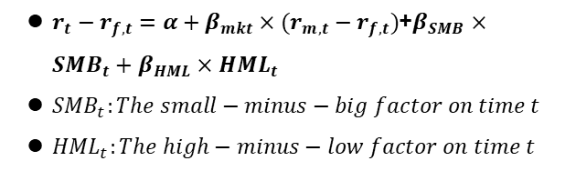
Microsoft
DCF-Step2: Estimate WACC
Estimate Cost of Equity
CAPM model:
• Time Series: 2011.6.1-2016.6.1
• Use the regression method to get 𝛽
$r_{t}−r_{f,t}=α+β_{mkt}×(r_{m,t}−r_{f,t})$
$r_{t}:Return of LinkedIn on time t$
$r_{f,t}:Risk−free rate on time t$
$r_{m,t}:Market return on time t$
Take CAPM model as an example:
• Estimate the model using historical data and obtain${ β}_{mkt}$
• Choose expected values for the market factor and risk-free rate
• Estimate required rate of return on equity:
Fama-French 3-factor model:
$r_{t}−r_{f,t}=α+β_{mkt}×(r_{m,t}−r_{f,t})$+$β_{SMB}×{SMB}_{t}+β_{HML}×{HML}_{t}$
${SMB}_{t}:The small−minus−big factor on time t$
${HML}_{t}:The high−minus−low factor on time t$
E($r_{t}$)= $β_{mkt}×[E\left(r_{m,t}−r_{f,t}\right)]$+E($r_{f,t}$)
Source: LinkedIn return
FF factors and risk-free rate from Kenneth French’s data library

Slide 46
Microsoft
DCF-Step2: Estimate WACC
Estimate Cost of Equity
Annualized average |  | Beta
$$r_{f}$$ | 0.05% | MKT (CAPM) | 1.715
MKT-$r_{f}$ | 10.09% | MKT (FF 3-factor) | 1.838
SMB | -0.67% | SMB | -0.591
HML | -0.69% | HML | -0.234
LinkedIn’s Expected Return
Calculate the average data.
Beta is calculated by regression.
Two returns are almost the same.
CAPM
FF 3-factor
17.36%
19.11%

Slide 47
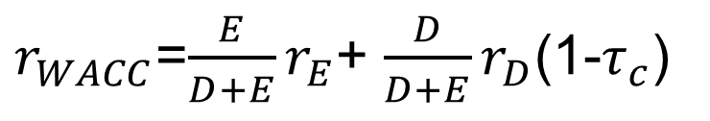
Microsoft
DCF-Step2: Estimate WACC
Cost of equity
Estimated cost of equity (CAPM) | 17.36%
Estimated cost of equity (FF 3-factor) | 19.11%
Weighted average cost of debt | 0.48%
Capital structure
Common shares outstanding (million) | 123.81
Share price on June 7, 2016 | $135.70
Market value of equity (million) | $16,801.02
Long-term debt (million) | $1,322.5
Total capitalization (million) | $18,123.52
Cost of debt
Tax rate as of 2015 | 33.10%
Weighted average cost of capital | 16.12%
$r_{WACC}$=$\frac{E}{D+E}r_{E}$+ $\frac{D}{D+E}r_{D}$(1-$τ_{c}$)

Slide 48
DCF-Step3: Calculate Terminal Value
Perpetuity growth method
01
Find long-term industry growth rate (g)
02
LinkedIn belongs to ICT industry
(Information,Communication, and Technology)
03
Obtain GDP of ICT industry from Bureau of Economic Analysis
04
The average industry GDP growth rate is 6.73% from 2001 to 2015 (2001 and 2009 are excluded!!)
Notes:
Step 3 is to calculate the terminal value.
We adopt two methods in this step, the perpetuity growth method, and the exit multiple method.
The first one is the perpetuity growth model. This model assumes LinkedIn’s future cash flows would grow at a constant rate g. Here we use long-term industry growth rate to represent it. LinkedIn belongs to the ICT industry, the full name is Information, Communication, and Technology. We obtain the industry GDP from this website and manually filter the data from 2000 to 2015. Then we use Excel to calculate the industry growth rate and take a simple average.

Slide 49
DCF-Step3: Calculate Terminal Value
GDP of Information-communications-technology-producing industries
Year | 2000 | 2001 | 2002 | 2003 | 2004 | 2005 | 2006 | 2007
Industry GDP(billion) | 632.8 | 610.2 | 620.9 | 653.1 | 706.2 | 755.4 | 795.1 | 853.1
Growth Rate |  | -3.57% | 1.75% | 5.19% | 8.13% | 6.97% | 5.26% | 7.29%
Bursting of the “dot-com bubble”
Year | 2008 | 2009 | 2010 | 2011 | 2012 | 2013 | 2014 | 2015
Industry GDP(billion) | 905 | 888.3 | 939.1 | 977.7 | 989.3 | 1065.2 | 1097.6 | 1183.6
Growth Rate | 6.08% | -1.85% | 5.72% | 4.11% | 1.19% | 7.67% | 3.04% | 7.84%
Financial crisis
6.73%
Perpetuity growth rate
Notes:
It's worth noting that here we exclude the growth rate data for 2001 and 2009.
You can see that only these two years’ growth rates are less than zero. It’s because, throughout the late 1990s and early 2000s, the internet industry experienced rapid growth. Many investors became overly optimistic about internet companies, leading to stock prices far exceeding their actual value. However, in 2000, the dot-com bubble began to burst, causing numerous internet companies to go bankrupt and investor confidence to decline. This resulted in a significant decrease in investment in the ICT sector, ultimately leading to a negative growth rate in 2001.
The reason for the negative growth rate in 2009 is obvious because of the global financial crisis.
Since we believe these two matters are non-recurring events, we exclude them here. Therefore, we concluded that the perpetuity growth rate for LinkedIn is 6.73%.

Slide 50
DCF-Step3: Calculate Terminal Value
 | Dec. 31, 2016 | Dec. 31, 2017 | Dec. 31, 2018 | Dec. 31, 2019 | Dec. 31, 2020
Projected free cash flow (thousand) | (60,636) | (45,220) | 96,569 | 259,732 | 446,595
Perpetuity growth method
Perpetuity growth rate | 6.73%
WACC | 16.12%
Terminal value (thousand) | $5,078,146.26
Implied exit multiple | 4.99
Calculate the TV of LinkedIn using estimated perpetuity growth rate, WACC, and FCF
Imply the exit multiple using perpetuity growth method
Notes:
Then we can combine the WACC and the future cash flows we estimated before to calculate the terminal value of LinkedIn. In this method, the terminal value is approximately 5 million and the implied exit multiple is 4.99.

Slide 51
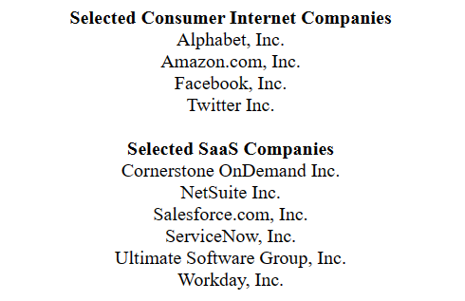
DCF-Step3: Calculate Terminal Value
Exit multiple method
Identify peer companies
Comparable companies | EBITDA multiple | Firm value ($ million) | EBITDA ($ million)
Facebook (Meta Platform Inc.) | 34.38 | 280,900 | 8,170
Amazon.com Inc. | 37.70 | 321,000 | 8,514
Google (Alphabet Inc.) | 18.99 | 463,700 | 24,423
Salesforce.com Inc. | 48.07 | 43,452 | 904
Baidu | 26.22 | 60,390 | 2,303
Tencent | 32.91 | 1,413,120 | 42,939
Source: LinkedIn Preliminary Proxy Statement
Notes:
The second model is the exit multiple method.
Initially, we should identify the peer companies of LinkedIn. We found the following companies in LinkedIn’s industry from its proxy statement. I believe these companies’ names are familiar to you, Amazon, Alphabet (Google), Facebook, and Twitter. And here are some SaaS companies that can also be regarded as competitives.
Since Yahoo Finance can only provide the EBITDA of 2022, we have manually downloaded the firm value and the EBITDA from Wind and calculated the EBITDA multiple. Here we use the first four companies’ data to take an average. The reasons why we only choose these four are that some companies’ data is invalid.
You can see that here we also listed the data of Baidu and Tencent but didn’t include them. Because we think though Baidu and Tencent are suitable comparable companies for LinkedIn, and they are both listed on Nasdaq, but their business is located in China. The Chinese government has different regulations for technology companies. Therefore, they can’t be directly compared, so we excluded their data here

Slide 52
DCF-Step3: Calculate Terminal Value
Exit multiple method
LinkedIn EBITDA (thousand) | $1,016,825.75
Exit multiple | 34.78
Terminal value (thousand) | $35,369,537.80
Implied perpetuity growth rate | 14.67%
Calculate the TV of LinkedIn using EBITDA multiples of peer companies
Source: Wind
Imply the perpetuity growth rate using exit multiple method
Notes:
The exit multiple calculated is 34.78. Combined with the EBITDA, we can calculate the terminal value, which is 35 million.
Then let my teammate compare these two models and determine the valuation for LinkedIn.

Slide 53
DCF-Step4: Calculate Present Value
Perpetuity growth method
Terminal Value (thousand) | $5,078,146.26
Perpetuity growth rate used | 6.73%
Implied exit multiple | 4.99
Exit multiple method
Terminal Value (thousand) | $35,369,537.80
Implied perpetuity growth rate | 14.67%
Exit multiple used | 34.78
($ thousand) | Dec. 31, 2016 | Dec. 31, 2017 | Dec. 31, 2018 | Dec. 31, 2019 | Dec. 31, 2020
Projected FCFs | (60,636) | (45,220) | 96,569 | 259,732 | 446,595
PV of FCF (WACC= 16.12%) | (52,220.23) | (33,538.08) | 61,681.20 | 142,871.96 | 211,563.75
Notes:
Here we list terminal value calculated by the two methods. Using perpetuity growth rate at 6%, we saw a 5 billion terminal value, while the number is much higher if calculated by exit multiple model, at 35 billion. To calculate present value, we here reviewed the free cash flow, which is derived from previous DCF model. And discounted them with wacc at 16% to get the present value of free cash flow.

Slide 54
DCF-Step4: Calculate Present Value
($ thousand, except share price) | Perpetuity growth method | Exit multiple method
Terminal Value | 5,078,146.26 | 35,369,537.80
Enterprise Value | 2,736,010.54 | 17,085,842.39
Total debt | 1,323,000
Preferred stock | -
Noncontrolling interest | 26,810
Cash and cash equivalents | 546,237
Implied equity value | 1,932,437.54 | 16,282,269.39
Common shares outstanding | 123,810
Implied share price | 15.61 | 131.51
Notes:
To calculate the value of the firm, we added up the present value of free cash flow with each terminal value. So that we found the enterprise value in perpetuity model is around 2.7 billion, and the figure is 17 billion when using the exit multiple method.
For this huge difference here, one possible reason we deduct is that LinkedIn is not a suitable candidate for the perpetual valuation due to its dynamic and fast-paced nature as a technology-based social networking platform. LinkedIn's business model is changing and uncertain, and its future cash flows are not guaranteed to remain stable and predictable over the long term.
However，since linkedin have a relatively stable financial performance and a strong market position, the exit multiple model seems to give a more proper result, at 17 billion.
After that, we subtract some items from the firm value to obtain the implied equity value, divided by shares outstanding, we finally gain the share price under the two different methods.

Slide 55
Sensitivity Analysis – WACC & g
Implied Enterprise Value |  |  | Q1 | Q2 | Q3 | Q4
 | EV ($ million) | Perpetuity growth rate
 | EV (thousand) | 4.73% | 5.73% | 6.73% | 7.73% | 8.73%
WACC | 12.12% | 3,967 | 4,565 | 5,386 | 6,580 | 8.479
 | 14.12% | 2,934 | 3,269 | 3,693 | 4,251 | 5,015
 | 16.12% | 2,275 | 2,483 | 2,736 | 3,046 | 3,443
 | 18.12% | 1,822 | 1,960 | 2,122 | 2,316 | 2,551
 | 20.12% | 1,492 | 1,589 | 1,701 | 1,830 | 1,982
Notes:
Next comes to the sensitivity analysis,. We firstly conducted the analysis between wacc and perpetuity growth rate.
It is obvious 2 percent change in WACC can lead to approximate 30% in the final valuation. while 1 percent change in growth rate can have 9% impact on enterprise value, and this margin will keep increasing when growth rate increases. which indicates that there is significant uncertainty about the firm value.

Slide 56
Sensitivity Analysis – WACC & exit multiple
Implied Share Price |  |  | Q1 | Q2 | Q3 | Q4
 | Share price ($) | Exit multiple
 | EV (thousand) | 30.78 | 32.78 | 34.78 | 36.78 | 38.78
WACC | 13.23% | 132.39 | 141.22 | 150.04 | 158.87 | 167.7
 | 15.08% | 121.55 | 129.69 | 137.83 | 145.97 | 154.11
 | 16.12% | 115.93 | 123.71 | 131.51 | 139.27 | 147.06
 | 17.86% | 107.14 | 114.36 | 121.58 | 128.81 | 136.03
 | 19.71% | 98.62 | 105.3 | 111.98 | 118.66 | 125.34
Notes:
Then, in the sensitivity analysis for wacc and exit multiple, 2% increase in wacc will lead to 8% decrease in share price, while 2 unit increase in multiple number, price will increases by 6%, which reveals more stable changes. So we choose exit multiple method to support our valuation.

Slide 57

Determine Valuation
Estimated enterprise value by exit multiple method
Enterprise value BEFORE announcement
Microsoft’s bid price
$17.1b
$17.5b
$26.2b
Implied enterprise value range by LinkedIn’s financial advisor
Enterprise value AFTER announcement
Premium～50%
$14.7-21.2b
$25.8b
Potential synergies
Bidding competition
Notes:
Finally, we determined the estimated enterprise value of 17.1 billion, compared with the estimation given by linkedin’s financial advisor Morgan Stanley, This value is within the range. Also, the firm value before the acquisition announcement is 17.5 billion, it surged 47 percent after the announcement to near 25.8 billion.
While Microsoft’s bid price is 26.2 billion, presenting a healthy premium of 50%.The reasons for a firm to pay such a high premium is that Microsoft believes there will be significant synergies attainable via this acquisition. LinkedIn could help Microsoft accelerate its shift to the internet by giving it a large online property. In addditon, A bidding war with Salesforce.com forced Microsoft to pay nearly $6 billion extra to seal its planned takeover of LinkedIn.
Conclusion: In conclusion, by building this DCF model and choose proper exit multiple, we finally estimate that Linkedin’s firm value will reach 17.1 billion in 2020, 5 years after the planned acquisition event. And Combined with other supportive data, it showed that Microsoft is biding a premium price. Although the payment is huge, it is believed that there will be great synergies with the help of the expansion in social networking field brought by Linkedin, which also can be seen as the motivation and purpose of this acquisition. That’all for our project.

Slide 58
Thanks!

